Slide 1





E-Commerce Security and Fraud Protection

Slide 2


Learning Objectives
Understand the importance and scope of security of information systems for EC.
Describe the major concepts and terminology of EC security.
Learn about the major EC security threats, vulnerabilities, and technical attacks.
Understand Internet fraud, phishing, and spam.
Describe the information assurance security principles.
Identify and assess major technologies and methods for securing EC access and communications.
9-1

Slide 3

Learning Objectives
Describe the major technologies for protection of EC networks.
Describe various types of controls and special defense mechanisms.
Describe consumer and seller protection from fraud.
Describe the role of business continuity and disaster recovery planning.
Discuss EC security’s enterprisewide implementation issues.
Understand why it is not possible to stop computer
crimes.
9-2

Slide 4

The Information Security Problem
information security
Protecting information and information systems from unauthorized access, use, disclosure, disruption, modification, perusal, inspection, recording or destruction
WHAT IS EC SECURITY?
CSI Computer Crime and Security Survey
Annual security survey of U.S. corporations, government agencies, financial and medical institutions, and universities conducted by the Computer Security Institute
9-3

Slide 5
The Information Security Problem
Personal Security
National Security
Security Risks for 2011–2012
Cyberwars, Cyberespionage, and Cybercrimes Across Borders
Types of Attacks
Corporate espionage that plagues businesses around the world
Political espionage and warfare
9-4

Slide 6
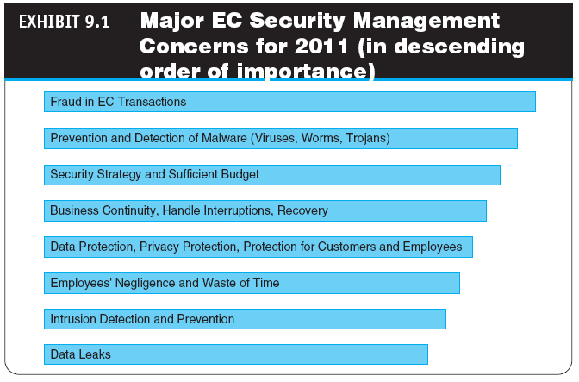
9-5

Slide 7

The Information Security Problem
THE DRIVERS OF EC SECURITY PROBLEMS
The Internet’s Vulnerable Design
Domain Name System (DNS)
Translates (converts) domain names to their numeric IP
addresses
IP address
An address that uniquely identifies each computer connected
to a network or the Internet
The Shift to Profit-Induced Crimes
9-6

Slide 8

The Information Security Problem
Internet underground economy
E-markets for stolen information made up of thousands of websites that sell credit card numbers, social security numbers, other data such as numbers of bank accounts, social network IDs, passwords, and much more
keystroke logging (keylogging)
A method of capturing and recording user keystrokes
The Dynamic Nature of EC Systems and the Role of
Insiders
WHY IS AN E-COMMERCE SECURITY STRATEGY NEEDED?
The Computer Security Strategy Dilemma
9-7

Slide 9
Basic E-commerce
Security Issues and Landscape
BASIC SECURITY TERMINOLOGY
business continuity plan
A plan that keeps the business running after a disaster occurs; each function in the business should have a valid recovery capability plan
cybercrime
Intentional crimes carried out on the Internet
cybercriminal
A person who intentionally carries out crimes over the Internet
9-8

Slide 10

Basic E-commerce
Security Issues and Landscape
exposure
The estimated cost, loss, or damage that can result if a threat exploits a vulnerability
fraud
Any business activity that uses deceitful practices or devices to deprive another of property or other rights
malware (malicious software)
A generic term for malicious software
phishing
A crimeware technique to steal the identity of a target company to get the identities of its customers
9-9

Slide 11
Basic E-Commerce
Security Issues and Landscape
risk
The probability that a vulnerability will be known and used
social engineering
A type of nontechnical attack that uses some ruse to trick users into revealing information or performing an action that compromises a computer or network
spam
The electronic equivalent of junk mail
9-10

Slide 12
Basic E-commerce
Security Issues and Landscape
vulnerability
Weakness in software or other mechanism that threatens the confidentiality, integrity, or availability of an asset (recall the CIA model); it can be directly used by a hacker to gain access to a system or network
zombies
Computers infected with malware that are under the
control of a spammer, hacker, or other criminal
9-11

Slide 13
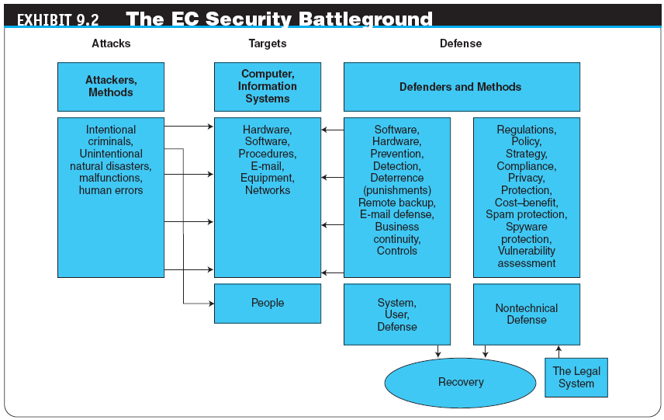
9-12

Slide 14

Basic E-Commerce
Security Issues and Landscape
THE THREATS, ATTACKS, AND ATTACKERS
Unintentional Threats
Intentional Attacks and Crimes
The Criminals and Methods
hacker
Someone who gains unauthorized access to a computer
system
cracker
A malicious hacker, such as Maxwell, in the opening case, who
may represent a serious problem for a corporation
9-13

Slide 15

Basic E-Commerce
Security Issues and Landscape
THE TARGETS OF THE ATTACKS IN VULNERABLE AREAS
Vulnerable Areas Are Being Attacked
The Vulnerabilities in Business IT and EC Systems
SECURITY SCENARIOS AND REQUIREMENTS IN E-COMMERCE
The Content of Information Security
9-14

Slide 16

Basic E-Commerce
Security Issues and Landscape
EC Security Requirements
authentication
Process to verify (assure) the real identity of an individual, computer, computer program, or EC website
authorization
Process of determining what the authenticated entity is allowed to access and what operations it is allowed to perform
Auditing
Availability
nonrepudiation
Assurance that online customers or trading partners cannot falsely deny (repudiate) their purchase or transaction
9-15

Slide 17

Basic E-Commerce
Security Issues and Landscape
THE DEFENSE: DEFENDERS, STRATEGY, AND METHODS
EC security strategy
A strategy that views EC security as the process of preventing and detecting unauthorized use of the organization’s brand, identity, website, e-mail, information, or other asset and attempts to defraud the organization, its customers, and employees
deterring measures
Actions that will make criminals abandon their idea of attacking a specific system (e.g., the possibility of losing a job for insiders)
9-16

Slide 18

Basic E-Commerce
Security Issues and Landscape
prevention measures
Ways to help stop unauthorized users (also known as “intruders”) from accessing any part of the EC system
detection measures
Ways to determine whether intruders attempted to break into the EC system; whether they were successful; and what they may have done
information assurance (IA)
The protection of information systems against unauthorized access to or modification of information whether in storage, processing, or transit, and against the denial of service to authorized users, including those measures necessary to detect, document, and counter such threats

Slide 19

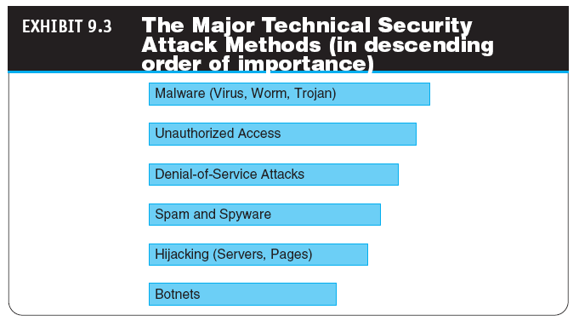

Slide 20

Technical Attack Methods:
From Viruses to Denial of Service
MALICIOUS CODE: VIRUSES, WORMS, AND TROJAN HORSES
virus
A piece of software code that inserts itself into a host, including the operating systems, in order to propagate; it requires that its host program be run to activate it
worm
A software program that runs independently, consuming the resources of its host in order to maintain itself, that is capable of propagating a complete working version of itself onto another machine

Slide 21
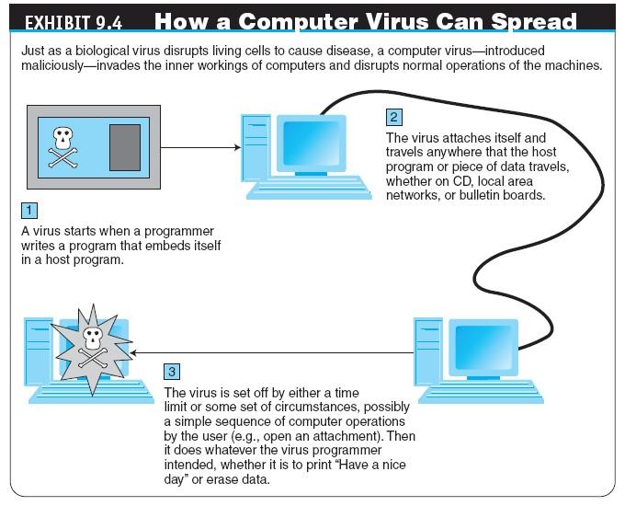

Slide 22
Technical Attack Methods:
From Viruses to Denial of Service
macro virus (macro worm)
A macro virus or macro worm is executed when the application object that contains the macro is opened or a particular procedure is executed
Trojan horse
A program that appears to have a useful function but that contains a hidden function that presents a security risk
banking Trojan
A Trojan that comes to life when computer owners visit one of a number of online banking or e-commerce sites

Slide 23

Technical Attack Methods:
From Viruses to Denial of Service
denial-of-service (DoS) attack
An attack on a website in which an attacker uses specialized software to send a flood of data packets to the target computer with the aim of overloading its resources
page hijacking
Creating a rogue copy of a popular website that shows contents similar to the original to a Web crawler; once there, an unsuspecting user is redirected to malicious websites

Slide 24
Technical Attack Methods:
From Viruses to Denial of Service
botnet
A huge number (e.g., hundreds of thousands) of hijacked Internet computers that have been set up to forward traffic, including spam and viruses, to other computers on the Internet
Malvertising

Slide 25

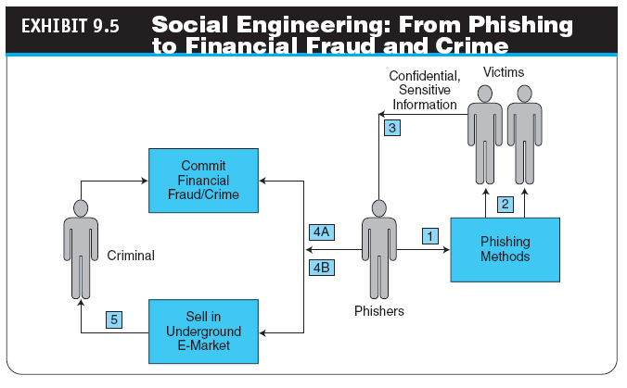

Slide 26

Nontechnical Methods: From Phishing To Spam
SOCIAL PHISHING
Sophisticated Phishing Methods
FRAUD ON THE INTERNET
Examples of Typical Online Fraud Attacks
Identity Theft and Identify Fraud
identity theft
Fraud that involves stealing an identity of a person and then the use of that identity by someone pretending to be someone else in order to steal money or get other benefits

Slide 27

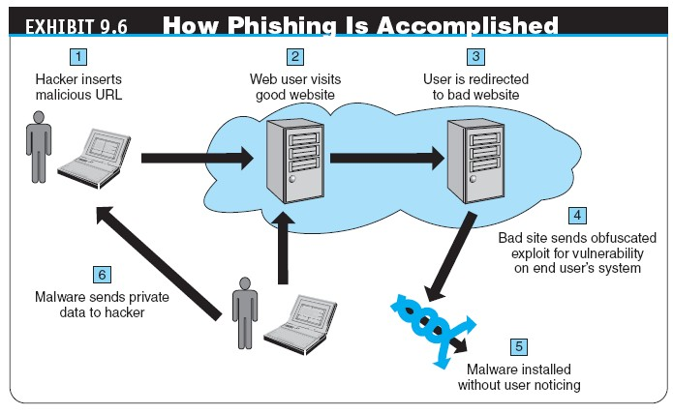

Slide 28

Nontechnical Methods: From Phishing To Spam
CYBER BANK ROBBERIES
Other Financial Fraud
SPAM AND SPYWARE ATTACKS
e-mail spam
A subset of spam that involves nearly identical messages sent to numerous recipients by e-mail
Typical Examples of Spamming
spyware
Software that gathers user information over an Internet connection without the user’s knowledge

Slide 29

Nontechnical Methods: From Phishing To Spam
SOCIAL NETWORKING MAKES SOCIAL ENGINEERING EASY
How Hackers Are Attacking Social Networks
Spam in Social Networks and in the Web 2.0 Environment

Slide 30
Nontechnical Methods: From Phishing To Spam
search engine spam
Pages created deliberately to trick the search engine into offering inappropriate, redundant, or poor-quality search results
spam site
Page that uses techniques that deliberately subvert a search engine’s algorithms to artificially inflate the page’s rankings
splog
Short for spam blog, a site created solely for marketing
purposes

Slide 31

Nontechnical Methods: From Phishing To Spam
data breach
A security incident in which sensitive, protected, or confidential data is copied, transmitted, viewed, stolen, or used by an individual unauthorized to do so

Slide 32
The Information Assurance Model and Defense Strategy
CIA security triad (CIA triad)
Three security concepts important to information on the Internet: confidentiality, integrity, and availability
confidentiality
Assurance of data privacy and accuracy; keeping private or sensitive information from being disclosed to unauthorized individuals, entities, or processes

Slide 33

The Information Assurance Model and Defense Strategy
integrity
Assurance that stored data has not been modified without authorization; a message that was sent is the same message as that which was received
availability
Assurance that access to data, the website, or other EC data service is timely, available, reliable, and restricted to authorized users

Slide 34

The Information Assurance Model and Defense Strategy
AUTHENTICATION, AUTHORIZATION, AND NONREPUDIATION
E-COMMERCE SECURITY STRATEGY
The Objective of Security Defense
Security Spending Versus Needs Gap
Assessing Security Needs
vulnerability assessment
The process of identifying, quantifying, and prioritizing the vulnerabilities in a system

Slide 35
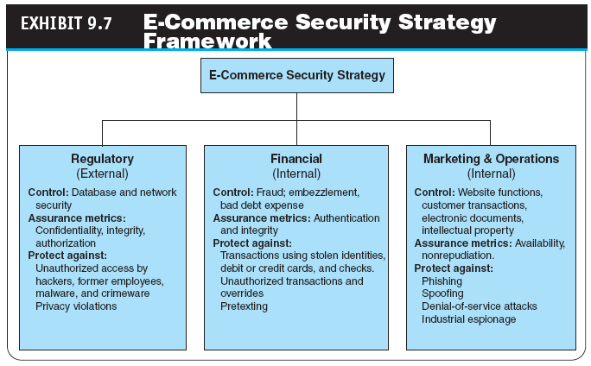

Slide 36

The Information Assurance Model and Defense Strategy
penetration test (pen test)
A method of evaluating the security of a computer system or a network by simulating an attack from a malicious source, (e.g., a cracker)
EC security programs
All the policies, procedures, documents, standards, hardware, software, training, and personnel that work together to protect information, the ability to conduct business, and other assets

Slide 37
The Information Assurance Model and Defense Strategy
computer security incident management
The monitoring and detection of security events on a computer or computer network, and the execution of proper responses to those events. The primary purpose of incident management is the development of a well understood and predictable response to damaging events and computer intrusions.

Slide 38

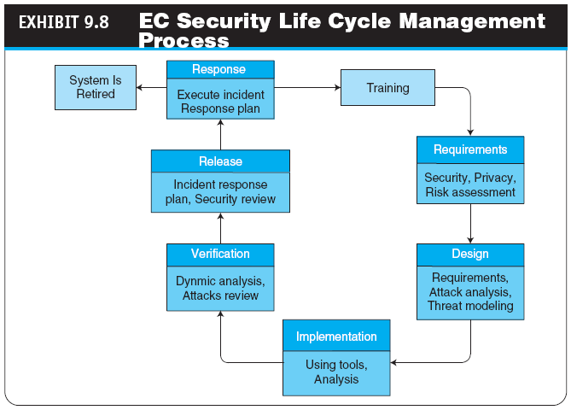

Slide 39

The Information Assurance Model and Defense Strategy
THE DEFENSE SIDE OF EC SYSTEMS
Defending access to computing systems, data flow, and EC transactions
Defending EC networks
General, administrative, and application controls
Protection against social engineering and fraud
Disaster preparation, business continuity, and risk management
Implementing enterprisewide security programs

Slide 40
The Defense I:
Access Control, Encryption, and PKI
access control
Mechanism that determines who can legitimately use a network resource
Authorization and Authentication
biometric control
An automated method for verifying the identity of a person based on physical or behavioral characteristics
biometric systems
Authentication systems that identify a person by measurement of a biological characteristic, such as fingerprints, iris (eye) patterns, facial features, or voice

Slide 41

The Defense I:
Access Control, Encryption, and PKI
ENCRYPTION AND THE ONE-KEY (SYMMETRIC) SYSTEM
encryption
The process of scrambling (encrypting) a message in such a way that it is difficult, expensive, or time-consuming for an unauthorized person to unscramble (decrypt) it
plaintext
An unencrypted message in human-readable form
ciphertext
A plaintext message after it has been encrypted into a machine-readable form

Slide 42

The Defense I:
Access Control, Encryption, and PKI
encryption algorithm
The mathematical formula used to encrypt the plaintext into the ciphertext, and vice versa
key (key value)
The secret code used to encrypt and decrypt a message
key space
The large number of possible key values (keys) created
by the algorithm to use when transforming the message

Slide 43

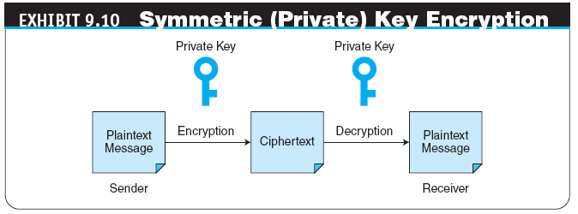

Slide 44

The Defense I:
Access Control, Encryption, and PKI
symmetric (private) key encryption
An encryption system that uses the same key to encrypt and decrypt the message
Data Encryption Standard (DES)
The standard symmetric encryption algorithm supported by the NIST and used by U.S. government agencies until October 2000

Slide 45

The Defense I:
Access Control, Encryption, and PKI
public key infrastructure (PKI)
A scheme for securing e-payments using public key encryption and various technical components
public (asymmetric) key encryption
Method of encryption that uses a pair of matched keys—a public key to encrypt a message and a private key to decrypt it, or vice versa
public key
Encryption code that is publicly available to anyone
private key
Encryption code that is known only to its owner

Slide 46
The Defense I:
Access Control, Encryption, and PKI
digital signature or digital certificate
Validates the sender and time stamp of a transaction so it cannot be later claimed that the transaction was unauthorized or invalid
hash function
A mathematical computation that is applied to a message, using a private key, to encrypt the message
message digest (MD)
A summary of a message converted into a string of digits after the hash has been applied

Slide 47

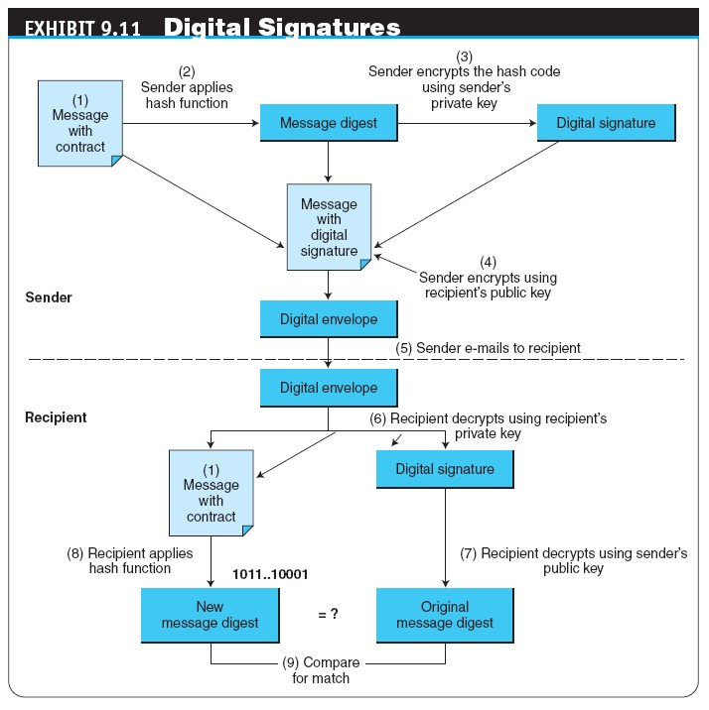

Slide 48
The Defense I:
Access Control, Encryption, and PKI
digital envelope
The combination of the encrypted original message and the digital signature, using the recipient’s public key
certificate authorities (CAs)
Third parties that issue digital certificates
Secure Socket Layer (SSL)

Slide 49

The Defense II:
Securing E-Commerce Networks
firewall
A single point between two or more networks where all traffic must pass (choke point); the device authenticates, controls, and logs all traffic
packet
Segment of data sent from one computer to another on a network
The Dual Firewall Architecture: The DMZ

Slide 50

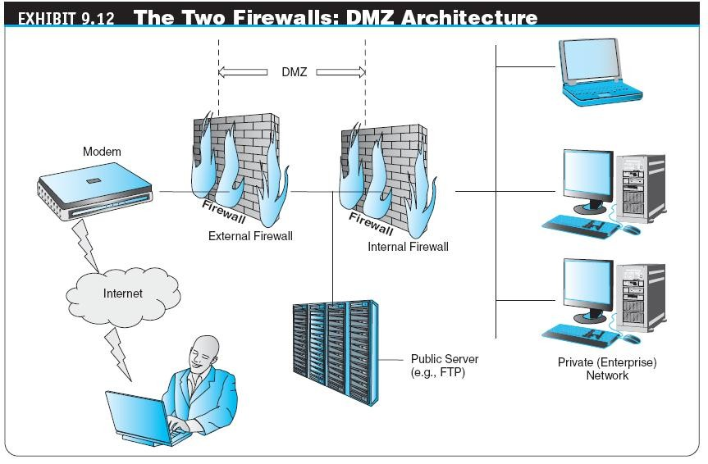

Slide 51
The Defense II:
Securing E-Commerce Networks
personal firewall
A network node designed to protect an individual user’s desktop system from the public network by monitoring all the traffic that passes through the computer’s network interface card
Additional Virus, Malware, and Botnet Protection

Slide 52

The Defense II:
Securing E-Commerce Networks
virtual private network (VPN)
A network that uses the public Internet to carry information but remains private by using encryption to scramble the communications, authentication to ensure that information has not been tampered with, and access control to verify the identity of anyone using the network
protocol tunneling
Method used to ensure confidentiality and integrity of data transmitted over the Internet by encrypting data packets, sending them in packets across the Internet, and decrypting them at the destination address

Slide 53
The Defense II:
Securing E-Commerce Networks
intrusion detection system (IDS)
A special category of software that can monitor activity across a network or on a host computer, watch for suspicious activity, and take automated action based on what it sees
Dealing with DoS Attacks
Cloud Computing Prevents DoS Attacks

Slide 54

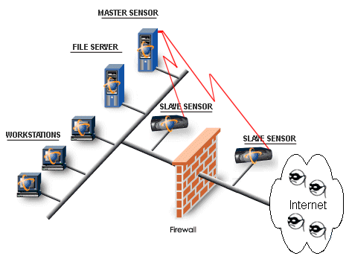

Slide 55
The Defense II:
Securing E-Commerce Networks
honeynet
A network of honeypots
honeypot
Production system (e.g., firewalls, routers, Web servers, database servers) that looks like it does real work, but that acts as a decoy and is watched to study how network intrusions occur
E-Mail Security

Slide 56

The Defense III: General Controls, Internal Controls, Compliance, and Other Defense Mechanisms
general controls
Controls established to protect the system regardless of the specific application; for example, protecting hardware and controlling access to the data center are independent of the specific application
application controls
Controls that are intended to protect specific applications

Slide 57

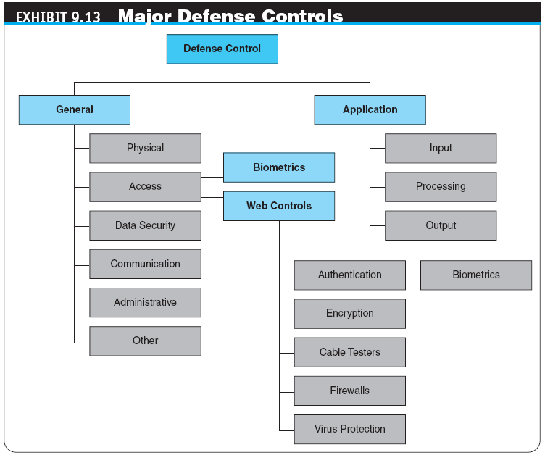

Slide 58
The Defense III: General Controls, Internal Controls, Compliance, and Other Defense Mechanisms
GENERAL, ADMINISTRATIVE, AND OTHER CONTROLS
Physical Controls
Administrative Controls
APPLICATION CONTROLS AND INTELLIGENT AGENTS
intelligent agents
Software applications that have some degree of reactivity, autonomy, and adaptability—as is needed in unpredictable attack situations; an agent is able to adapt itself based on changes occurring in its environment

Slide 59

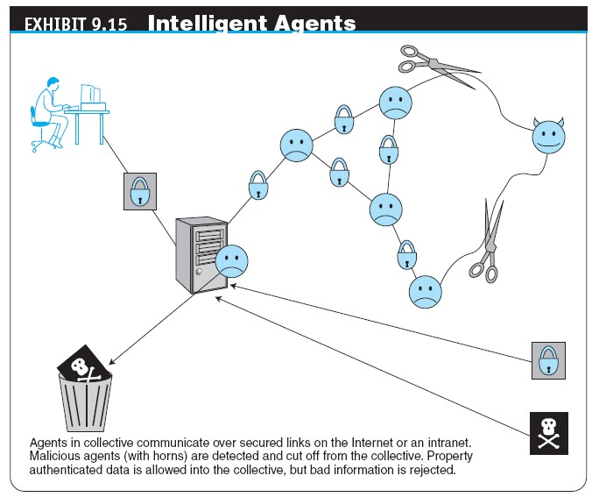

Slide 60
The Defense III: General Controls, Internal Controls, Compliance, and Other Defense Mechanisms
PROTECTING AGAINST SPAM
Controlling the Assault of Non-Solicited Pornography and Marketing (CAN-SPAM) Act
Law that makes it a crime to send commercial e-mail messages with false or misleading message headers or misleading subject lines

Slide 61

The Defense III: General Controls, Internal Controls, Compliance, and Other Defense Mechanisms
PROTECTING AGAINST POP-UP ADS
PROTECTING AGAINST SOCIAL ENGINEERING ATTACKS
Protecting Against Phishing
Protecting Against Malvertising
PROTECTING AGAINST SPYWARE
Using Policies and Training

Slide 62
Business Continuity, Disaster Recovery, Security Auditing, and Risk Management
BUSINESS CONTINUITY AND DISASTER RECOVERY PLANNING
disaster avoidance
An approach oriented toward prevention, the idea is to minimize the chance of avoidable disasters (such as fire or other human-caused threats)

Slide 63

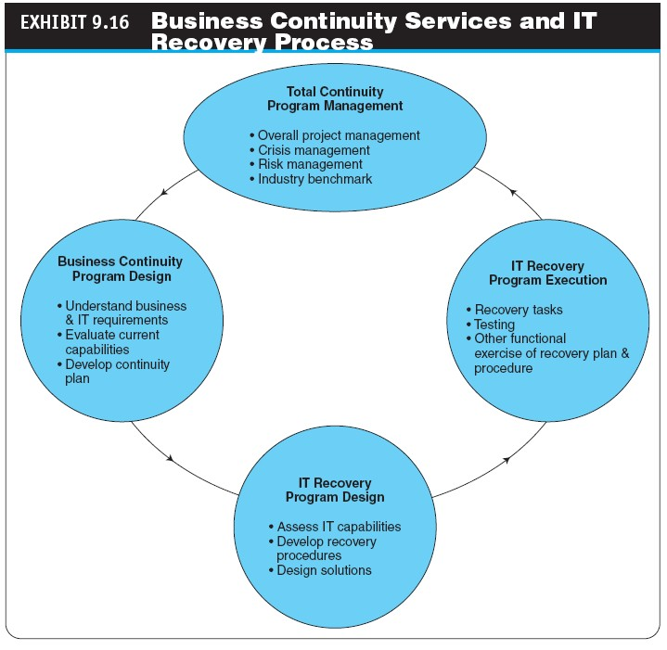

Slide 64

Business Continuity, Disaster Recovery, Security Auditing, and Risk Management
RISK-MANAGEMENT AND COST–BENEFIT ANALYSIS
Risk-Management Analysis
Calculating the Cost of a Fraud-Prevention System
Ethical Issues

Slide 65
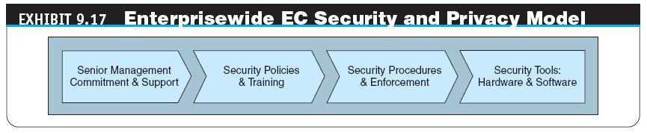
Implementing
Enterprisewide E-Commerce Security
THE DRIVERS OF EC SECURITY MANAGEMENT
SENIOR MANAGEMENT COMMITMENT AND SUPPORT
Unified Front

Slide 66

Implementing
Enterprisewide E-Commerce Security
EC SECURITY POLICIES AND TRAINING
acceptable use policy (AUP)
Policy that informs users of their responsibilities when using company networks, wireless devices, customer data, and so forth
EC SECURITY PROCEDURES AND ENFORCEMENT
business impact analysis (BIA)
An exercise that determines the impact of losing the support of an EC resource to an organization and establishes the escalation of that loss over time, identifies the minimum resources needed to recover, and prioritizes the recovery of processes and supporting systems

Slide 67
Implementing
Enterprisewide E-Commerce Security
WHY IS IT DIFFICULT TO STOP INTERNET CRIME?
Making Shopping Inconvenient
Lack of Cooperation from Credit Card Issuers and ISPs
Shoppers’ Negligence
Ignoring EC Security Best Practices
Computing Technology Industry Association (CompTIA) Nonprofit trade group providing information security research and best practices

Slide 68
Implementing
Enterprisewide E-Commerce Security
Design and Architecture Issues
Lack of Due Care in Business Practices
standard of due care
Care that a company is reasonably expected to take based on
the risks affecting its EC business and online transactions

Slide 69
Managerial Issues
What is the best EC security strategy for my company?
Is the budget for EC security adequate?
What steps should businesses follow in establishing a security plan?
Should organizations be concerned with internal security threats?
What is the key to establishing strong e-commerce
security?

Slide 70

Summary
The key to establishing strong e-commerce security
Basic EC security issues and terminology
Threats, vulnerabilities, and technical attacks
Internet fraud, phishing, and spam
Information assurance
Securing EC access control and communications

Slide 71

Summary
Technologies for protecting networks.
The different controls and special defense mechanisms.
Protecting from fraud.
Role of business continuity and disaster recovery planning.
Enterprisewide EC security.
Why is it impossible to stop computer crimes?

Slide 72

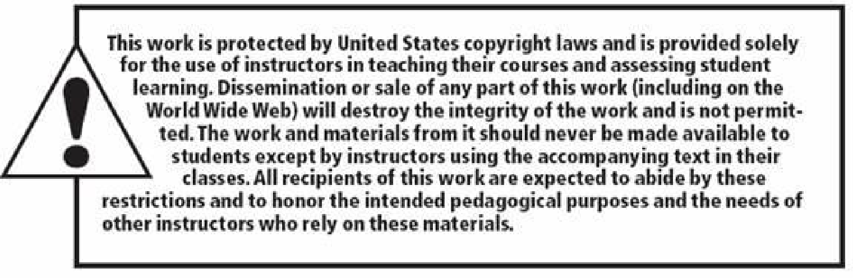




All rights reserved. No part of this publication may be reproduced, stored in a retrieval system, or transmitted, in any form or by any means, electronic, mechanical, photocopying, recording, or otherwise, without the prior written permission of the publisher. Printed in the United States of America.
Copyright © 2012 Pearson Education, Inc.
Publishing as Prentice Hall

